Slide 1


SAP S/4HANA Training
MASTER DATA GOVERNANCE (SAP MDG)
Neeraj Gupta
Session 03
SAP MDG – Deployment, Synchronization

Slide 2
1. SAP MDG Training Objectives & Agenda: Training schedule
I
Day 1
Lesson 1 – Overview of Enterprise Information Management
Lesson 2 - Introduction to Master Data Governance
Day 2
Lesson 3 - MDG Architecture
Lesson 4 – MDG Data Domains & Deployment
Day 3
Lesson 5 – Data Modelling
Lesson 6 – Configurations, standard & extended models
Day 4
Lesson 7 – Hierarchies & relationships
Lesson 8 - Standard & Custom Data Models
Day 5
(Exercises)
Lesson 9 - Data Model – extensibility use cases
Day 6
Lesson 9 – UI Modelling
Lesson 10 – Customization, CBA
Day 7
Lesson 11 – Process Modelling
Day 8
Lesson 12 - Governance scope, Change Requests
Lesson 13 – Workflow process modelling
Day 9
Lesson 14 – Using Rule Based Workflows
Day 10
Lesson 15 – Exercises using Business activities for Data
Lesson 16 – Data Quality & Search

Slide 3
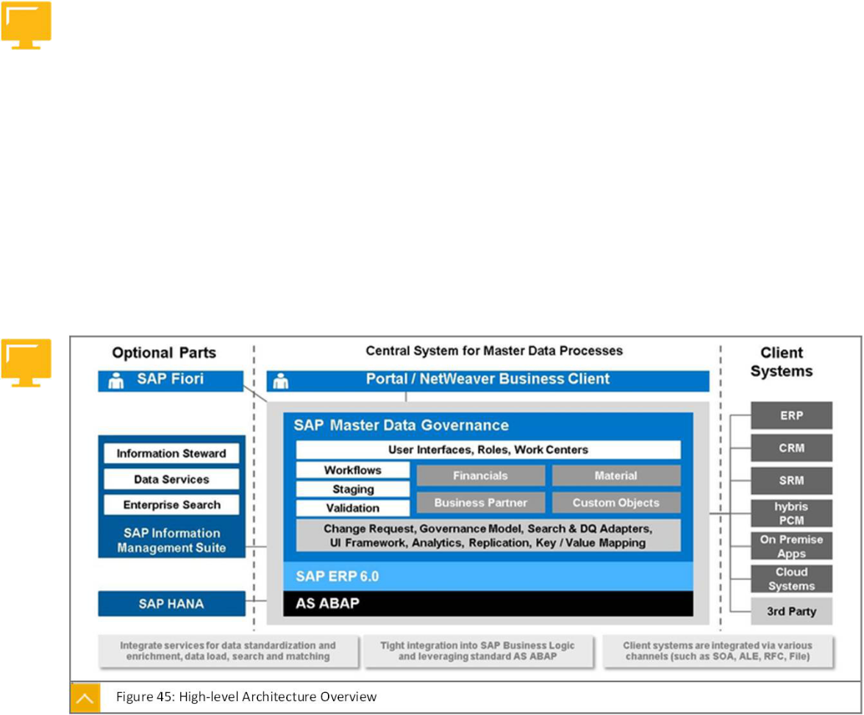
MDG Architecture
3
SAP MDG – Architecture & Deployment

Slide 4
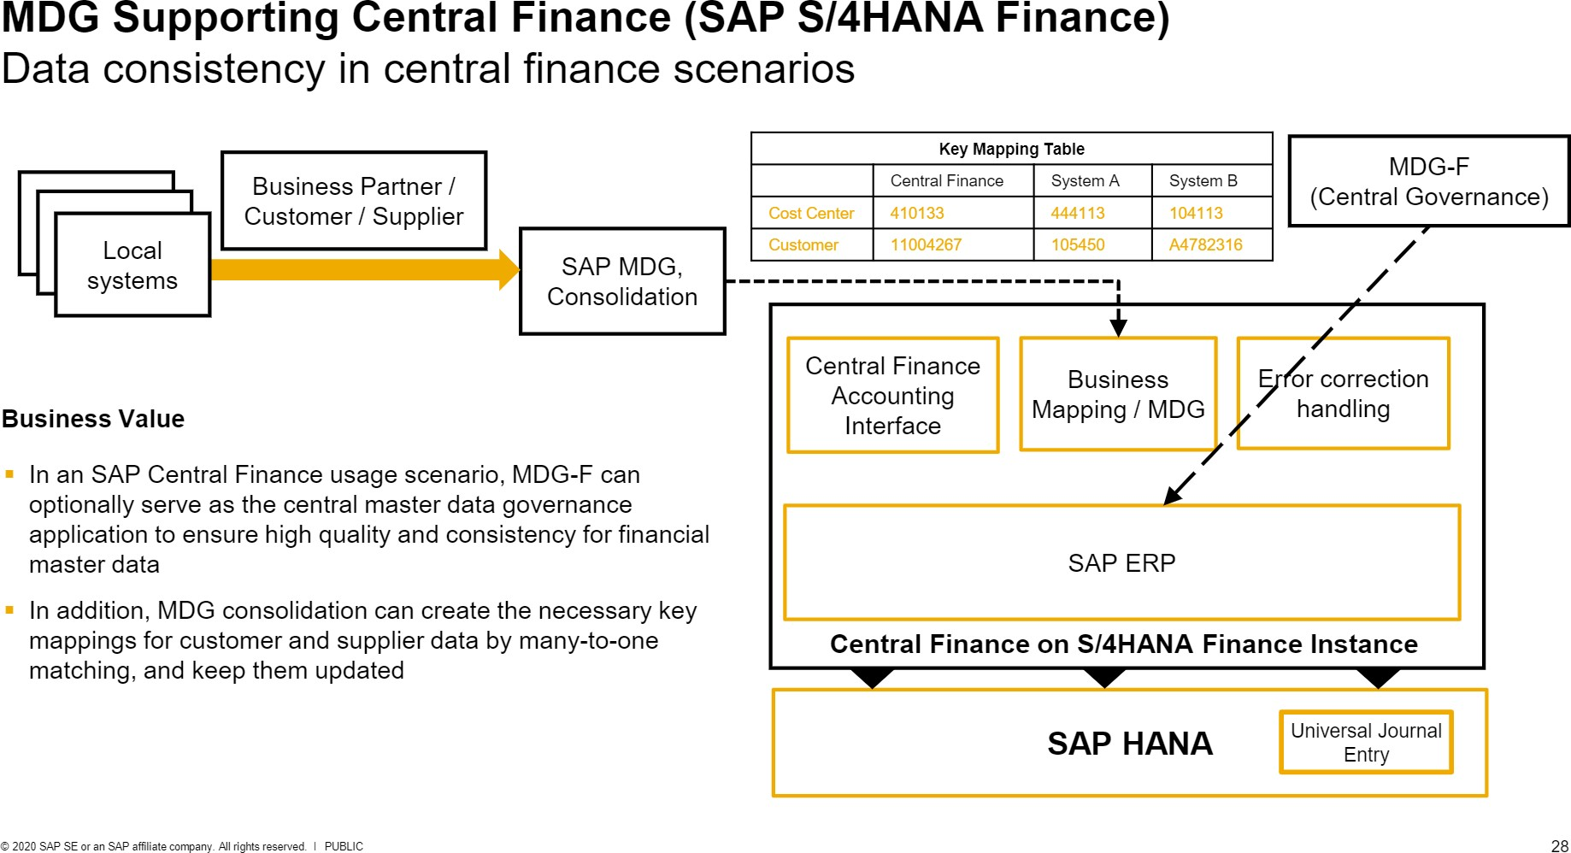
3
SAP MDG – Architecture & Deployment

Slide 5
3
SAP MDG – Architecture & Deployment
Hub approach vs Co-deployment approach
Customizing Synchronization
Reference Master Data Synchronization

Slide 6
3
SAP MDG – Architecture & Deployment
Hub approach vs Co-deployment approach (Customizing synchronization Approach)
1. Business configuration sets (BC Sets)
2. Customizing Transports (TMS Framework)
3. SAP Solution manager (Automated Option)
a. Customizing Distribution
b. Customizing Scout
c. XLD (Focused Build standalone extension (using workbench requests and Change Request Management)
4. ALE Customizing Distribution (Also for REF master data sync.)
5. System / client copy with customizing data (Restricted)
6. Choice of Database in ERP (ECC) system

Slide 7
3
SAP MDG – Architecture & Deployment
Hub approach vs Co-deployment approach (Customizing synchronization Approach)
Initial Synchronization
Ongoing synchronization
Semi-automatic synchronization
Custom solution
ALE-Based Customizing Distribution
SAP Solution Manager Based Customizing Distribution

Slide 8
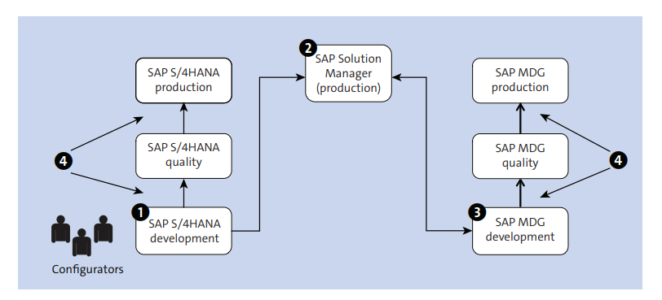
SAP solution manager based customizing process for ongoing synchronization
3
SAP MDG – Architecture & Deployment

Slide 9
3
SAP MDG – Architecture & Deployment
Customizing synchronizing setup

Slide 10
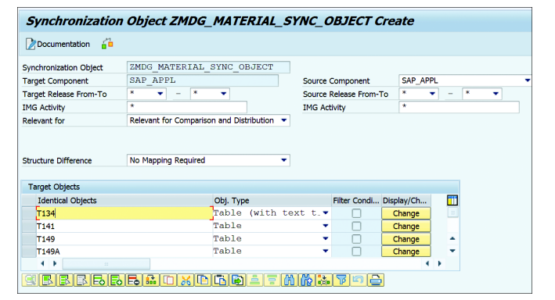
3
SAP MDG – Architecture & Deployment
Synchronizing Object creation

Slide 11
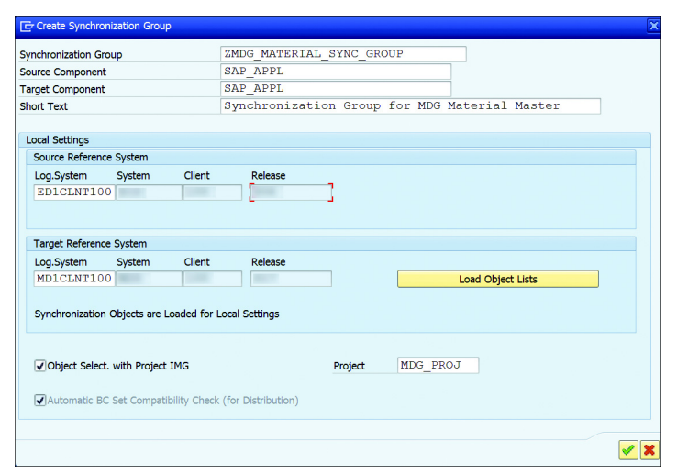
3
SAP MDG – Architecture & Deployment
Synchronizing Group creation

Slide 12
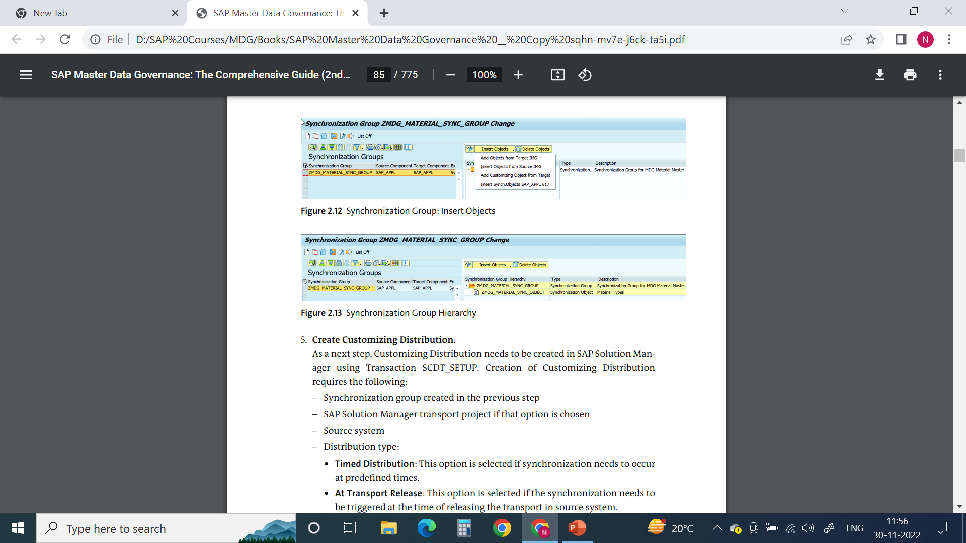

3
SAP MDG – Architecture & Deployment
Synchronizing Group : Insert Objects
Synchronizing Group Hierarchy

Slide 13
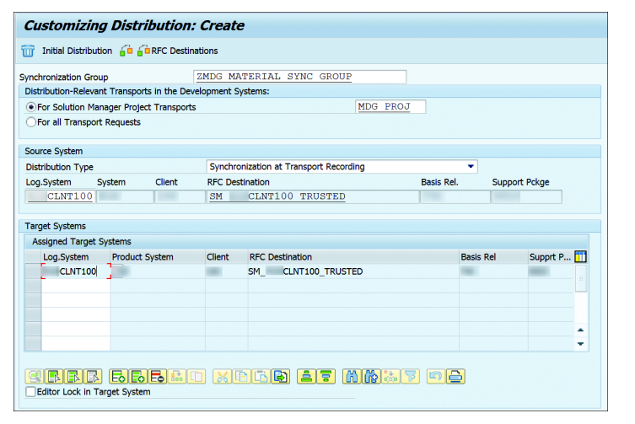
3
SAP MDG – Architecture & Deployment
Customizing Distribution

Slide 14
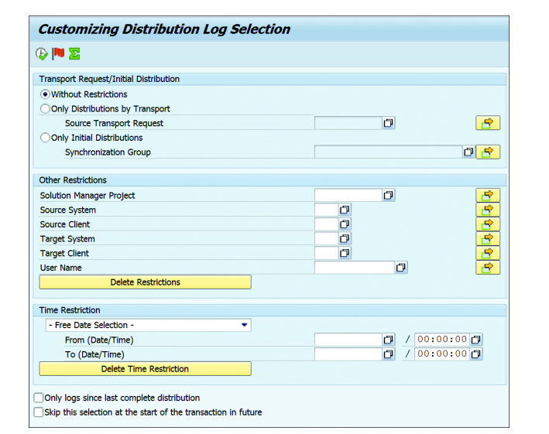
3
SAP MDG – Architecture & Deployment
Distribution Log: SCDT_LOG

Slide 15
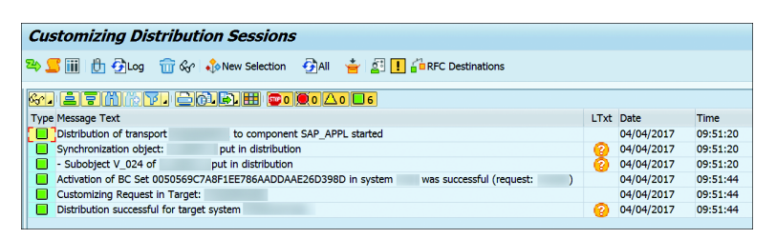
3
SAP MDG – Architecture & Deployment
Distribution Log example

Slide 16
3
SAP MDG – Architecture & Deployment
Customizing Scout

Slide 17
3
SAP MDG – Architecture & Deployment
Customizing Scout comparison based on synchronization group

Slide 18
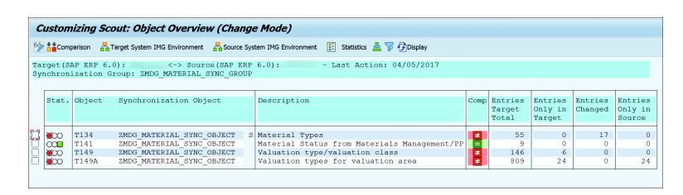
3
SAP MDG – Architecture & Deployment
Customizing Scout comparison result: example

Slide 19

End of Session 03

Slide 20

Questions

Slide 21

Neeraj gupta

Slide 22


We’re committed to empower you to be
Most Desirable Resource
through powerful training solutions.
We build the workforce of the future.
250+
Corporate Clients
30,000+
Learners Trained
25000+
Learners Placed
FREE WEBINARS
Sign up for free webinars with industry experts every fortnight!
Enroll Now!
Contact us today!
https://anubhavtrainings.com/

Slide 23




More from AnubhavTrainings.com

